Slide 1

CSCE 3110
Data Structures and Algorithms
Graph III

Slide 2
Floyd–Warshall Algorithm
Main idea:
To decrease the distance d(s, t) between two vertices s and t, we can try to add some intermediate vertices in the path s→t.
If adding a new vertex u can decrease the distance d(s, t), i.e.,
d(s, u)+d(u, t)<d(s, t)
we need to update d(s, t)=d(s, u)+d(u, t)
Otherwise, we do nothing

Slide 3
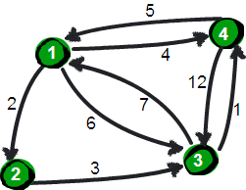
Example
Image credit: https://www.cnblogs.com/wangyuliang/p/9216365.html

Slide 4
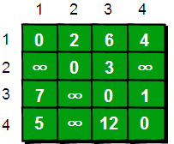
Example
initial d₀(s, t): not adding any vertex

Slide 5
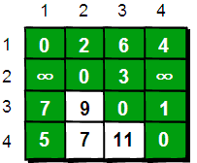
Example
updated d₁(s, t): adding vertex 1 to the path
initial d₀(s, t): not adding any vertex

Slide 6
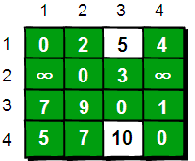
Example
updated d₁(s, t): adding vertex 1 to the path
initial d₀(s, t): not adding any vertex
updated d₂(s, t): adding vertices 1 and 2 to the path

Slide 7
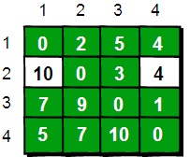
Example
updated d₁(s, t): adding vertex 1 to the path
initial d₀(s, t): not adding any vertex
updated d₃(s, t): adding vertices 1, 2 and 3 to the path
updated d₂(s, t): adding vertices 1 and 2 to the path

Slide 8
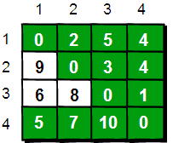
Example
updated d₁(s, t): adding vertex 1 to the path
initial d₀(s, t): not adding any vertex
updated d₄(s, t): adding vertices 1, 2, 3 and 4 to the path
updated d₃(s, t): adding vertices 1, 2 and 3 to the path
updated d₂(s, t): adding vertices 1 and 2 to the path

Slide 9
Algorithm
5 lines, incredibly simple:
for (k=1; k<=n; k++)
for (i=1; i<=n; i++)
for (j=1; j<=n; j++)
if (d(i, j) > d(i, k) + d(k, j)
d(i, j) = d(i, k) + d(k, j)

Slide 10
Question
How to obtain the shortest path by modifying the algorithm?

Slide 11
Algorithm
6 lines, still incredibly simple:
for (k=1; k<=n; k++)
for (i=1; i<=n; i++)
for (j=1; j<=n; j++)
if (d(i, j) > d(i, k) + d(k, j)
d(i, j) = d(i, k) + d(k, j);
next(i, j) = next(i, k);

Slide 12




Example
updated d₁(s, t): adding vertex 1 to the path
initial d₀(s, t): not adding any vertex
updated d₃(s, t): adding vertices 1, 2 and 3 to the path
updated d₂(s, t): adding vertices 1 and 2 to the path

